Slide 1





Module 03 – Exception handling
WWW.SELACLOUD.COM

Slide 2

Agenda
Exceptions Intro
Exceptions handling
Argument of an Exception
Raising Exceptions
User-Defined Exceptions
Logging
Logging to a file
Logging from multiple modules
Logging variable data

Slide 3
Exceptions Intro
An exception is an error that happens during the execution of a program. When that error occurs, Python generates an exception that can be handled
Unhandled exceptions cause your program to crash.
Exceptions come in different types. Python generates an exception with type, suitable to an error
The words "try", except" and "finally" are Python keywords that used to catch exceptions.
Exceptions can be raised (thrown) using "raise" statement
Notes:
Python is dynamically-typed and garbage-collected. It supports multiple programming paradigms, including structured (particularly, procedural), object-oriented and functional programming.
It was built to be as readable as possible, and is significant indentation driven (Off-side rule).
The language's core philosophy is summarized in the document The Zen of Python (PEP 20), which includes aphorisms such as:
Beautiful is better than ugly.
Explicit is better than implicit.
Simple is better than complex.
Complex is better than complicated.
Readability counts.
For further reading:
Python (programming language) - Wikipedia

Slide 4
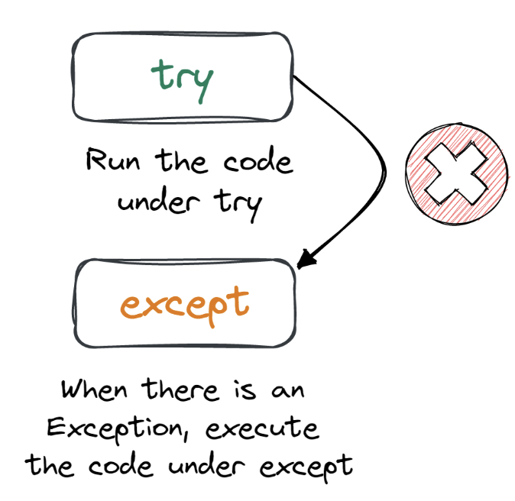
Exceptions Intro — cont’d
For Example:
try:
print(1/0)
except ZeroDivisionError:
print ("You can't divide by zero")
Notes:
Python is dynamically-typed and garbage-collected. It supports multiple programming paradigms, including structured (particularly, procedural), object-oriented and functional programming.
It was built to be as readable as possible, and is significant indentation driven (Off-side rule).
The language's core philosophy is summarized in the document The Zen of Python (PEP 20), which includes aphorisms such as:
Beautiful is better than ugly.
Explicit is better than implicit.
Simple is better than complex.
Complex is better than complicated.
Readability counts.
For further reading:
Python (programming language) - Wikipedia

Slide 5
Some Built-in Exception Errors
Below is some common exceptions errors in Python:
Exception Base class for all exceptions
lOError If the file cannot be opened.
ImportError If python cannot find the module
ValueError Raised when built-in function receives an inappropriate value
KeyError Raised when the specified key is not found in the dictionary.
NameError Raised when an identifier is not found in the local or global namespace.
EOFError Raised when one of the built-in functions (input() or raw_input()) hits an end-of-file condition (EOF) without reading any data
ArithmeticError The base exceptions for various arithmetic errors: OverflowError, ZeroDivisionError, FloatingPointError
SyntaxError Raised when the syntax is incorrect

Slide 6
Exception handling example

Slide 7
Version 1:
If the input is not numeric, "67a" for example, the code — raises exception:
ValueError: invalid literal for int() with base 10: ‘67a’
s = input("Enter a number between 1 - 10") number = int(s) print ("your number is — {}".format(number))

Slide 8
Version 2:
The program will continue running whether the input is correct or not.
number =5 try: s = input("Enter a number between 1-10, 5 is default") number = int(s) except ValueError: print ("your value is incorrect, default value is set") print ("your number is — {}".format(number))
Notes:
PyCharm is currently one of the most used IDE for python development, It provides code analysis, a graphical debugger, an integrated unit tester, integration with version control systems (VCSes), and supports web development with Django as well as data science with Anaconda.
It was created by JetBrains
It is mostly popular because of many things, such as:
It is considered as an intelligent code editor, fast and safe refactoring, and smart code.
Features for debugging, profiling, remote development, testing the code, auto code completion, quick fixing, error detection and tools of the database.
Support for Popular web technologies, web frameworks, scientific libraries and version control.

Slide 9
Lab 01

Slide 10
Argument of an Exception
Anexception can have an argument, that holds an additional information about the problem and cause of the exception
try:
print(val + 10)
except NameError as ne:
print(ne)
File "<stdin>", line 1, in <module>
NameError: name '‘val' is not defined
Notes:
PyCharm is currently one of the most used IDE for python development, It provides code analysis, a graphical debugger, an integrated unit tester, integration with version control systems (VCSes), and supports web development with Django as well as data science with Anaconda.
It was created by JetBrains
It is mostly popular because of many things, such as:
It is considered as an intelligent code editor, fast and safe refactoring, and smart code.
Features for debugging, profiling, remote development, testing the code, auto code completion, quick fixing, error detection and tools of the database.
Support for Popular web technologies, web frameworks, scientific libraries and version control.

Slide 11
Multiple excepts
try statement supports multiple excepts
try:
……
except ValueError as ve:
……
except ArithmeticError as ae:
……
except Exception:
……
Notes:
PyCharm is currently one of the most used IDE for python development, It provides code analysis, a graphical debugger, an integrated unit tester, integration with version control systems (VCSes), and supports web development with Django as well as data science with Anaconda.
It was created by JetBrains
It is mostly popular because of many things, such as:
It is considered as an intelligent code editor, fast and safe refactoring, and smart code.
Features for debugging, profiling, remote development, testing the code, auto code completion, quick fixing, error detection and tools of the database.
Support for Popular web technologies, web frameworks, scientific libraries and version control.

Slide 12
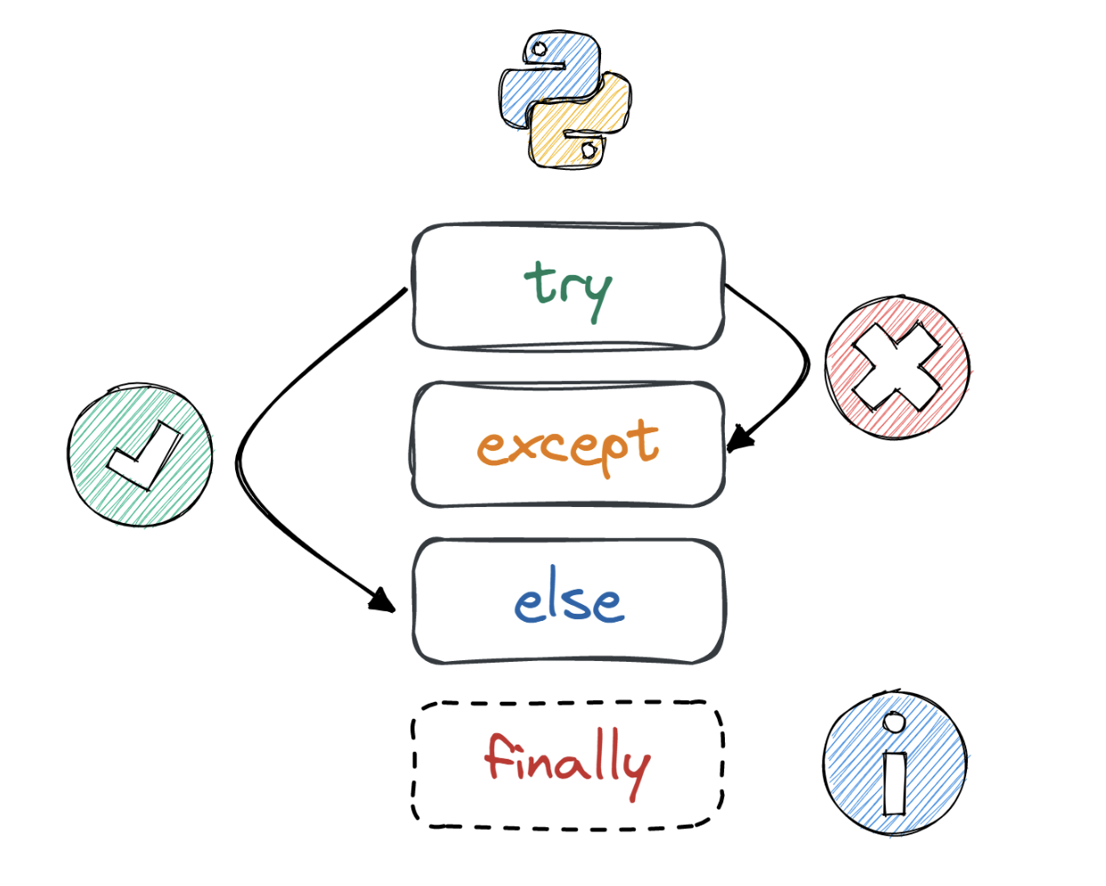
Try ... finally example
fo = open("some file","r")
try:
# work with file
finally:
fo.close()
Notes:
PyCharm is currently one of the most used IDE for python development, It provides code analysis, a graphical debugger, an integrated unit tester, integration with version control systems (VCSes), and supports web development with Django as well as data science with Anaconda.
It was created by JetBrains
It is mostly popular because of many things, such as:
It is considered as an intelligent code editor, fast and safe refactoring, and smart code.
Features for debugging, profiling, remote development, testing the code, auto code completion, quick fixing, error detection and tools of the database.
Support for Popular web technologies, web frameworks, scientific libraries and version control.

Slide 13
Raising Exceptions
The raise statement allows the programmer to force a specinie exception to occur
raise can come with a parameter (or several parameters). The parameter is a message or any additional information about the error
raise usually placed in infrastructure methods, classes and modules.
Notes:
PyCharm is currently one of the most used IDE for python development, It provides code analysis, a graphical debugger, an integrated unit tester, integration with version control systems (VCSes), and supports web development with Django as well as data science with Anaconda.
It was created by JetBrains
It is mostly popular because of many things, such as:
It is considered as an intelligent code editor, fast and safe refactoring, and smart code.
Features for debugging, profiling, remote development, testing the code, auto code completion, quick fixing, error detection and tools of the database.
Support for Popular web technologies, web frameworks, scientific libraries and version control.

Slide 14
Raising Exceptions

Slide 15
Raising Exceptions
def check_grade_validation(grade_value): if type(grade_value) != int: raise TypeError("grade value must be integer") if grade_value < 0 or grade_value>100: raise ValueError("grade value must be between O — 100")
Notes:
PyCharm is currently one of the most used IDE for python development, It provides code analysis, a graphical debugger, an integrated unit tester, integration with version control systems (VCSes), and supports web development with Django as well as data science with Anaconda.
It was created by JetBrains
It is mostly popular because of many things, such as:
It is considered as an intelligent code editor, fast and safe refactoring, and smart code.
Features for debugging, profiling, remote development, testing the code, auto code completion, quick fixing, error detection and tools of the database.
Support for Popular web technologies, web frameworks, scientific libraries and version control.

Slide 16
User-Defined Exceptions
Python has many built-in exceptions
Sometimes we may need to create a custom exceptions that serves our purpose.
Python, supports creation of a custom exception by defining a new class that derives from Exception built in class
Usually custom exceptions add some additional information
Notes:
PyCharm is currently one of the most used IDE for python development, It provides code analysis, a graphical debugger, an integrated unit tester, integration with version control systems (VCSes), and supports web development with Django as well as data science with Anaconda.
It was created by JetBrains
It is mostly popular because of many things, such as:
It is considered as an intelligent code editor, fast and safe refactoring, and smart code.
Features for debugging, profiling, remote development, testing the code, auto code completion, quick fixing, error detection and tools of the database.
Support for Popular web technologies, web frameworks, scientific libraries and version control.

Slide 17
User-Defined Exceptions

Slide 18
User-Defined Exceptions
class ValidationError(Exception): def __init__(self, message, errors): Exception.__init__(self, message) # base class __init__ self.errors = errors def __str__(self): return "{}, error is {}".format(Exception.__str__(self) ,self.error)
Notes:
PyCharm is currently one of the most used IDE for python development, It provides code analysis, a graphical debugger, an integrated unit tester, integration with version control systems (VCSes), and supports web development with Django as well as data science with Anaconda.
It was created by JetBrains
It is mostly popular because of many things, such as:
It is considered as an intelligent code editor, fast and safe refactoring, and smart code.
Features for debugging, profiling, remote development, testing the code, auto code completion, quick fixing, error detection and tools of the database.
Support for Popular web technologies, web frameworks, scientific libraries and version control.

Slide 19
Lab 02

Slide 20
Logging
Logging is a means of tracking events that happen when some software runs.
The software’s developer adds logging calls to their code to indicate that certain events have occurred.
An event is described by a descriptive message which can optionally contain variable data (i.e. data that is potentially different for each occurrence of the event).
Events also have an importance which the developer ascribes to the event; the importance can also be called the level or severity.
Notes:
PyCharm is currently one of the most used IDE for python development, It provides code analysis, a graphical debugger, an integrated unit tester, integration with version control systems (VCSes), and supports web development with Django as well as data science with Anaconda.
It was created by JetBrains
It is mostly popular because of many things, such as:
It is considered as an intelligent code editor, fast and safe refactoring, and smart code.
Features for debugging, profiling, remote development, testing the code, auto code completion, quick fixing, error detection and tools of the database.
Support for Popular web technologies, web frameworks, scientific libraries and version control.

Slide 21
When to use logging?
Logging provides a set of convenience functions for simple logging usage. These are debug(), info(), warning(), error() and critical(). To determine when to use logging, see the table below, which states, for each of a set of common tasks, the best tool to use for it.
Task you want to perform | The best tool for the task
Display console output for ordinary usage of a command line script or program | print()
Report events that occur during normal operation of a program (e.g. for status monitoring or fault investigation) | logging.info() (or logging.debug() for very detailed output for diagnostic purposes)
Issue a warning regarding a particular runtime event | warnings.warn() in library code if the issue is avoidable and the client application should be modified to eliminate the warning logging.warning() if there is nothing the client application can do about the situation, but the event should still be noted
Report an error regarding a particular runtime event | Raise an exception
Report suppression of an error without raising an exception (e.g. error handler in a long-running server process) | logging.error(), logging.exception() or logging.critical() as appropriate for the specific error and application domain
Notes:
PyCharm is currently one of the most used IDE for python development, It provides code analysis, a graphical debugger, an integrated unit tester, integration with version control systems (VCSes), and supports web development with Django as well as data science with Anaconda.
It was created by JetBrains
It is mostly popular because of many things, such as:
It is considered as an intelligent code editor, fast and safe refactoring, and smart code.
Features for debugging, profiling, remote development, testing the code, auto code completion, quick fixing, error detection and tools of the database.
Support for Popular web technologies, web frameworks, scientific libraries and version control.

Slide 22
When to use logging?
The logging functions are named after the level or severity of the events they are used to track. The standard levels and their applicability are described below (in increasing order of severity):
Level | When it’s used
DEBUG | Detailed information, typically of interest only when diagnosing problems.
INFO | Confirmation that things are working as expected.
WARNING | An indication that something unexpected happened, or indicative of some problem in the near future (e.g. ‘disk space low’). The software is still working as expected.
ERROR | Due to a more serious problem, the software has not been able to perform some function.
CRITICAL | A serious error, indicating that the program itself may be unable to continue running.
Notes:
PyCharm is currently one of the most used IDE for python development, It provides code analysis, a graphical debugger, an integrated unit tester, integration with version control systems (VCSes), and supports web development with Django as well as data science with Anaconda.
It was created by JetBrains
It is mostly popular because of many things, such as:
It is considered as an intelligent code editor, fast and safe refactoring, and smart code.
Features for debugging, profiling, remote development, testing the code, auto code completion, quick fixing, error detection and tools of the database.
Support for Popular web technologies, web frameworks, scientific libraries and version control.

Slide 23
Logging simple example

Slide 24
Example
import logging logging.warning('Watch out!') # will print a message to the console logging.info('I told you so') # will not print anything
Notes:
PyCharm is currently one of the most used IDE for python development, It provides code analysis, a graphical debugger, an integrated unit tester, integration with version control systems (VCSes), and supports web development with Django as well as data science with Anaconda.
It was created by JetBrains
It is mostly popular because of many things, such as:
It is considered as an intelligent code editor, fast and safe refactoring, and smart code.
Features for debugging, profiling, remote development, testing the code, auto code completion, quick fixing, error detection and tools of the database.
Support for Popular web technologies, web frameworks, scientific libraries and version control.

Slide 25
Logging to a file
A very common situation is that of recording logging events in a file, so let’s look at that next. Be sure to try the following in a newly started Python interpreter, and don’t just continue from the session described above:
The encoding argument was added. In earlier Python versions, or if not specified, the encoding used is the default value used by open(). While not shown in the above example, an errors argument can also now be passed, which determines how encoding errors are handled. For available values and the default, see the documentation for open().
And now if we open the file and look at what we have, we should find the log messages:
DEBUG:root:This message should go to the log file
INFO:root:So should this
WARNING:root:And this, too
ERROR:root:And non-ASCII stuff, too, like Øresund and Malmö
import logging logging.basicConfig(filename='example.log', encoding='utf-8', level=logging.DEBUG) logging.debug('This message should go to the log file') logging.info('So should this') logging.warning('And this, too') logging.error('And non-ASCII stuff, too, like Øresund and Malmö')
Notes:
PyCharm is currently one of the most used IDE for python development, It provides code analysis, a graphical debugger, an integrated unit tester, integration with version control systems (VCSes), and supports web development with Django as well as data science with Anaconda.
It was created by JetBrains
It is mostly popular because of many things, such as:
It is considered as an intelligent code editor, fast and safe refactoring, and smart code.
Features for debugging, profiling, remote development, testing the code, auto code completion, quick fixing, error detection and tools of the database.
Support for Popular web technologies, web frameworks, scientific libraries and version control.

Slide 26
Logging to a file – cont’d
To get the value which you’ll pass to basicConfig() via the level argument. You may want to error check any user input value, perhaps as in the following example:
The call to basicConfig() should come before any calls to debug(), info(), etc. Otherwise, those functions will call basicConfig() for you with the default options. As it’s intended as a one-off simple configuration facility, only the first call will actually do anything: subsequent calls are effectively no-ops.
# assuming loglevel is bound to the string value obtained from the # command line argument. Convert to upper case to allow the user to # specify --log=DEBUG or --log=debug numeric_level = getattr(logging, loglevel.upper(), None) if not isinstance(numeric_level, int): raise ValueError('Invalid log level: %s' % loglevel) logging.basicConfig(level=numeric_level, ...)
Notes:
PyCharm is currently one of the most used IDE for python development, It provides code analysis, a graphical debugger, an integrated unit tester, integration with version control systems (VCSes), and supports web development with Django as well as data science with Anaconda.
It was created by JetBrains
It is mostly popular because of many things, such as:
It is considered as an intelligent code editor, fast and safe refactoring, and smart code.
Features for debugging, profiling, remote development, testing the code, auto code completion, quick fixing, error detection and tools of the database.
Support for Popular web technologies, web frameworks, scientific libraries and version control.

Slide 27
Logging to a file – cont’d
If you run the above script several times, the messages from successive runs are appended to the file example.log. If you want each run to start afresh, not remembering the messages from earlier runs, you can specify the filemode argument, by changing the call in the above example to:
The output will be the same as before, but the log file is no longer appended to, so the messages from earlier runs are lost.
logging.basicConfig(filename='example.log', filemode='w', level=logging.DEBUG)
Notes:
PyCharm is currently one of the most used IDE for python development, It provides code analysis, a graphical debugger, an integrated unit tester, integration with version control systems (VCSes), and supports web development with Django as well as data science with Anaconda.
It was created by JetBrains
It is mostly popular because of many things, such as:
It is considered as an intelligent code editor, fast and safe refactoring, and smart code.
Features for debugging, profiling, remote development, testing the code, auto code completion, quick fixing, error detection and tools of the database.
Support for Popular web technologies, web frameworks, scientific libraries and version control.

Slide 28
Logging from multiple modules
If your program consists of multiple modules, here’s an example of how you could organize logging in it:
# myapp.py import logging import mylib def main(): logging.basicConfig(filename='myapp.log', level=logging.INFO) logging.info('Started') mylib.do_something() logging.info('Finished') if __name__ == '__main__': main()
# mylib.py import logging def do_something(): logging.info('Doing something')
Notes:
PyCharm is currently one of the most used IDE for python development, It provides code analysis, a graphical debugger, an integrated unit tester, integration with version control systems (VCSes), and supports web development with Django as well as data science with Anaconda.
It was created by JetBrains
It is mostly popular because of many things, such as:
It is considered as an intelligent code editor, fast and safe refactoring, and smart code.
Features for debugging, profiling, remote development, testing the code, auto code completion, quick fixing, error detection and tools of the database.
Support for Popular web technologies, web frameworks, scientific libraries and version control.

Slide 29
Logging from multiple modules – cont’d
If you run myapp.py, you should see this in myapp.log:
INFO:root:Started
INFO:root:Doing something
INFO:root:Finished
Which is hopefully what you were expecting to see. You can generalize this to multiple modules, using the pattern in mylib.py. Note that for this simple usage pattern, you won’t know, by looking in the log file, where in your application your messages came from, apart from looking at the event description.
Notes:
PyCharm is currently one of the most used IDE for python development, It provides code analysis, a graphical debugger, an integrated unit tester, integration with version control systems (VCSes), and supports web development with Django as well as data science with Anaconda.
It was created by JetBrains
It is mostly popular because of many things, such as:
It is considered as an intelligent code editor, fast and safe refactoring, and smart code.
Features for debugging, profiling, remote development, testing the code, auto code completion, quick fixing, error detection and tools of the database.
Support for Popular web technologies, web frameworks, scientific libraries and version control.

Slide 30
Logging variable data
To log variable data, use a format string for the event description message and append the variable data as arguments. For example:
will display:
WARNING:root:Look before you leap!
As you can see, merging of variable data into the event description message uses the old, %-style of string formatting. This is for backwards compatibility: the logging package pre-dates newer formatting options such as str.format() and string.Template.
import logging logging.warning('%s before you %s', 'Look', 'leap!')
Notes:
PyCharm is currently one of the most used IDE for python development, It provides code analysis, a graphical debugger, an integrated unit tester, integration with version control systems (VCSes), and supports web development with Django as well as data science with Anaconda.
It was created by JetBrains
It is mostly popular because of many things, such as:
It is considered as an intelligent code editor, fast and safe refactoring, and smart code.
Features for debugging, profiling, remote development, testing the code, auto code completion, quick fixing, error detection and tools of the database.
Support for Popular web technologies, web frameworks, scientific libraries and version control.

Slide 31
Changing the format of displayed messages
To change the format which is used to display messages, you need to specify the format you want to use:
which would print:
DEBUG:This message should appear on the console
INFO:So should this
WARNING:And this, too
import logging logging.basicConfig(format='%(levelname)s:%(message)s', level=logging.DEBUG) logging.debug('This message should appear on the console') logging.info('So should this') logging.warning('And this, too')
Notes:
PyCharm is currently one of the most used IDE for python development, It provides code analysis, a graphical debugger, an integrated unit tester, integration with version control systems (VCSes), and supports web development with Django as well as data science with Anaconda.
It was created by JetBrains
It is mostly popular because of many things, such as:
It is considered as an intelligent code editor, fast and safe refactoring, and smart code.
Features for debugging, profiling, remote development, testing the code, auto code completion, quick fixing, error detection and tools of the database.
Support for Popular web technologies, web frameworks, scientific libraries and version control.

Slide 32
Displaying the date/time in messages
To display the date and time of an event, you would place ‘%(asctime)s’ in your format string:
which should print something like this:
2010-12-12 11:41:42,612 is when this event was logged.
The default format for date/time display (shown above) is like ISO8601 or RFC 3339. If you need more control over the formatting of the date/time, provide a datefmt argument to basicConfig, as in this example:
which would display something like this:
12/12/2010 11:46:36 AM is when this event was logged.
import logging logging.basicConfig(format='%(asctime)s %(message)s') logging.warning('is when this event was logged.')
import logging logging.basicConfig(format='%(asctime)s %(message)s', datefmt='%m/%d/%Y %I:%M:%S %p') logging.warning('is when this event was logged.')
Notes:
PyCharm is currently one of the most used IDE for python development, It provides code analysis, a graphical debugger, an integrated unit tester, integration with version control systems (VCSes), and supports web development with Django as well as data science with Anaconda.
It was created by JetBrains
It is mostly popular because of many things, such as:
It is considered as an intelligent code editor, fast and safe refactoring, and smart code.
Features for debugging, profiling, remote development, testing the code, auto code completion, quick fixing, error detection and tools of the database.
Support for Popular web technologies, web frameworks, scientific libraries and version control.

Slide 33
Lab 03

